Slide 1
OSI Reference Model

Slide 2
Objectives
Data communication among heterogeneous systems – difficulties and solutions
The need for layered architecture
Design issues for the layers
The OSI model

Slide 3
Network complexities
Different types of hardware and software
Different operating systems
Different types of data to be transferred – text, images, music, video, etc
Data must be transferred without errors
Many different paths may have to be taken
Yet computers must communicate with each other in a network

Slide 4
Network complexities
Data formats and data exchange conventions vary between manufacturers
  E.g., ASCII, EBCDIC, etc.
This can be resolved only if computers follow certain common set of rules or protocols

Slide 5
How to Reduce this complexity
Recall concepts of functions, data hiding, passing values to as function, getting results from a function
How the function works is not important – what inputs it requires and what outputs it produces are important
“Black box” approach – services provided are known but the details are hidden

Slide 6
What is a protocol?
It is a formal description of message formats and the rules that two computers must follow in order to exchange messages.
This set of rules describes how data is transmitted over a network.

Slide 7
Why are protocols needed?
Protocols are needed for communication between any two devices.
  In what format will the messages be transmitted?
  At what speed should messages be transmitted?
  What to do if errors take place?
  What to do if parts of a message are lost?

Slide 8
Protocols in daily life
How does conversation take place between human beings
  “Hello”
  “Goodbye”
  Handshake
Letters
  “Dear Sir”
  “Yours faithfully”
  No splleing mistakes !

Slide 9
Network Model
What is a model? – A hypothetical description of a complex entity or process.
Network model - A method of describing and analyzing data communications networks by breaking the entire set of communications process into a number of layers
Each layer has a specific function

Slide 10
Open Systems Interconnect (OSI) Model
Who made:
  International Standards Organization (ISO)
A Model of How Protocols and Networking Components Could be Made
“Open” means the concepts are non-proprietary; can be used by anyone.
OSI is not a protocol. It is a model for understanding and designing a network architecture that is flexible and robust.

Slide 11
Open Systems Interconnect (OSI) Model
The OSI model describes how data flows from one computer, through a network to another computer
The OSI model divides the tasks involved with moving information between networked computers into 7 smaller, more manageable sub-task .
A task is then assigned to each of the seven OSI layers.
Each layer is reasonably self-contained so that the tasks assigned to each layer can be implemented independently.

Slide 12
Network Architecture
A set of layers and protocols is called a network architecture
It refers to the physical and logical design of a network

Slide 13
7-layer OSI model
Why so many layers?
  To reduce complexity, networks are organized as a stack of layers, one below the other
  Each layer performs a specific task. It provides services to an adjacent layer
  This is similar to the concept of a function in programming languages – function does a specific task

Slide 14
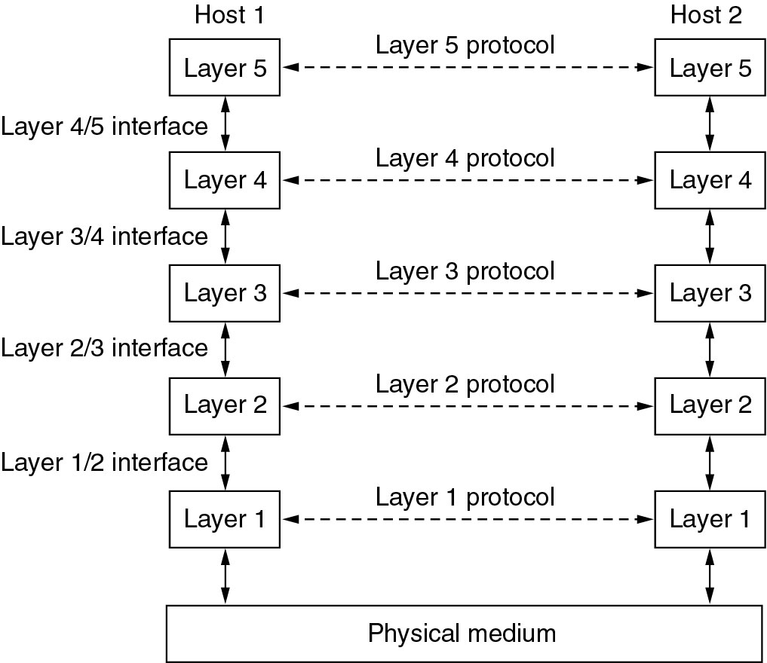
Layered Approach
Peers

Slide 15
Layered Approach
The entities comprising the corresponding layers on different machines are called peers
It is the peers that communicate by using the protocols
Actually, data is not transferred from layer n on one machine to layer n on another machine
Each layer passes data and control information to the layer immediately below it, until the lowest layer is reached
Actual data communication takes place through the lowest layer – the physical layer

Slide 16
Design Issues for the Layers
Addressing
Error control
Order of messages must be preserved
Flow control – fast sender and slow receiver !
Disassembling, transmitting, and reassembling large messages
Multiplexing / de-multiplexing
Routing
Notes:
Addressing – specify with which machine to communicate
Error detecting and error correcting codes can be used provided same mechanism is being used at both ends
Order of messages must be preserved. Messages may arrive out of order – i.e. not in the sequence. The protocol must allow the receiver to reassemble the pices properly, in the required sequence.
Flow control – A fast sender should not swamp a slow receiver. Some kind of feedback is required between sender and receiver in order to limit the data transfer rate.
Arbitrarily long messages must be broken down into smaller messages. These small messages are then transmitted and reassembled at the receiving end.
Multiplexing/de-multiplexing – use a single connection for multiple, unrelated conversations
Routing – if multiple paths exist between source and destination, which path to use. Various factors may come into play – urgency, speed, volume of data, etc.

Slide 17
Concept of Services and Protocols
A service is a set of operations that a layer provides to the layer above it
Service defines what operations the layer is prepared to perform
A service relates to the interface between two layers – the lower layer is service provider and the upper layer is service user

Slide 18
Concept of Services and Protocols
A protocol is a set of rules governing the format and meaning of the packets
Protocols relate to packets sent between peer entities on different machines
Entities use protocols
Protocols can be changed provided the services visible to the user do not change. Thus services and protocols are completely decoupled

Slide 19
Services and Protocols
Analogy with programming languages
  A service is like an object in an object-oriented language
  What operations can be performed on this object is defined
  How these operations are to be performed is not defined
Protocol relates to the implementation of the service – how it is done

Slide 20
The Layers of the OSI Model
Application
Presentation
Session
Transport
Network
Data Link
Physical

Slide 21
The Layers of the OSI Model
Some Mnemonics
All
People
Seem
To
Need
Data
Processing
Application
Presentation
Session
Transport
Network
Data Link
Physical
Please
Do
Not
Tell
Secret
Passwords
Anytime

Slide 22
Physical layer
Specifications for the physical components of the network.
Functions of Physical Layer:
  Bit representation – encode bits into electrical or optical signals
  Transmission rate – The number of bits sent each second
  Physical characteristics of transmission media
  Synchronizing the sender and receiver clocks
  Transmission mode – simplex, half-duplex, full duplex
  Physical Topology – how devices are connected – ring, star, mesh, bus topology
Application
Presentation
Session
Transport
Network
Data Link
Physical
Notes:
1. This layer is concerned with issues such as signal durations, voltage levels (what voltage represents a 0 and what represents a 1), types of connectors, assignment of pins on connectors

Slide 23
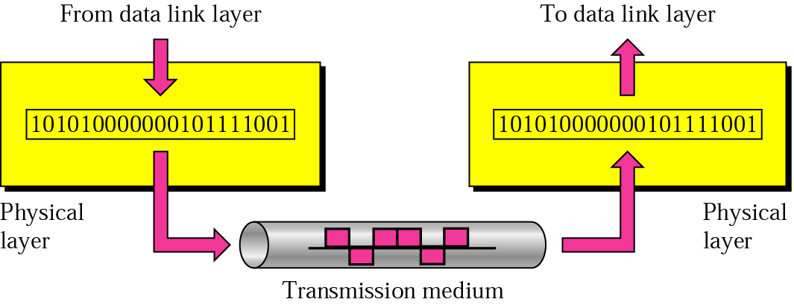
Physical Layer

Slide 24
Data Link Layer
Responsible for delivery of data between two systems on the same network
Main functions of this layer are:
  Framing – divides the stream of bits received from network layer into manageable data units called frames.
  Physical Addressing – Add a header to the frame to define the physical address of the source and the destination machines.
  Flow control – Impose a flow control – control rate at which data is transmitted so as not to flood the receiver (Feedback-based flow control)
  Error Control – Adds mechanisms to detect and retransmit damaged or lost frames. This is achieved by adding a trailer to the end of a frame
Application
Presentation
Session
Transport
Network
Data Link
Physical

Slide 25
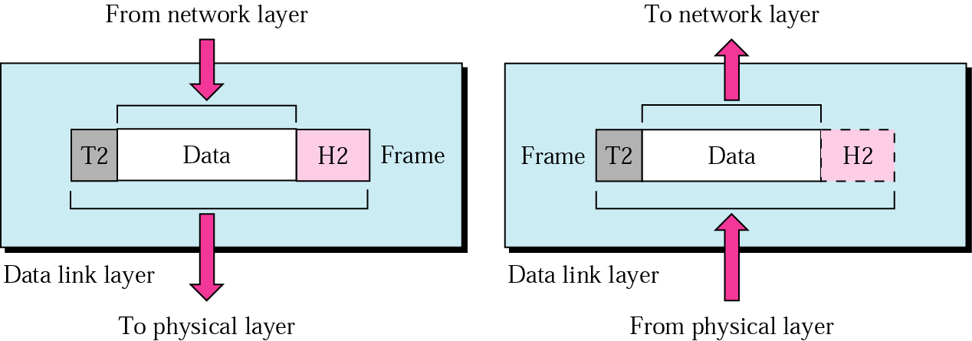
Data Link Layer

Slide 26
Network Layer
Main functions of this layer are:
  Responsible for delivery of packets across multiple networks
  Routing – Provide mechanisms to transmit data over independent networks that are linked together.
  Network layer is responsible only for delivery of individual packets and it does not recognize any relationship between those packets
Application
Presentation
Session
Transport
Network
Data Link
Physical

Slide 27
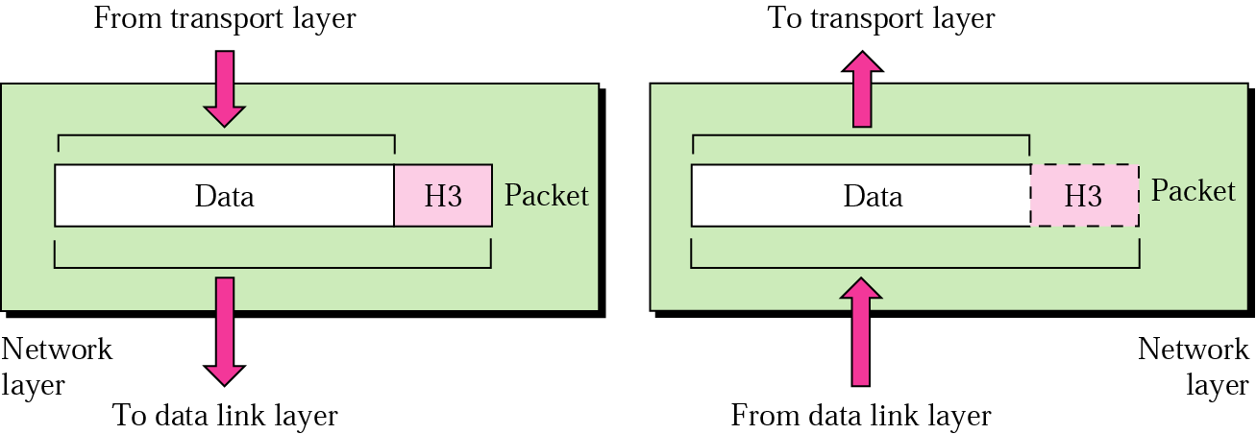
Network Layer

Slide 28
Transport Layer
Main functions of this layer are:
  Responsible for source-to-destination delivery of the entire message
  Segmentation and reassembly – divide message into smaller segments, number them and transmit. Reassemble these messages at the receiving end.
  Error control – make sure that the entire message arrives without errors – else retransmit.
Application
Presentation
Session
Transport
Network
Data Link
Physical

Slide 29
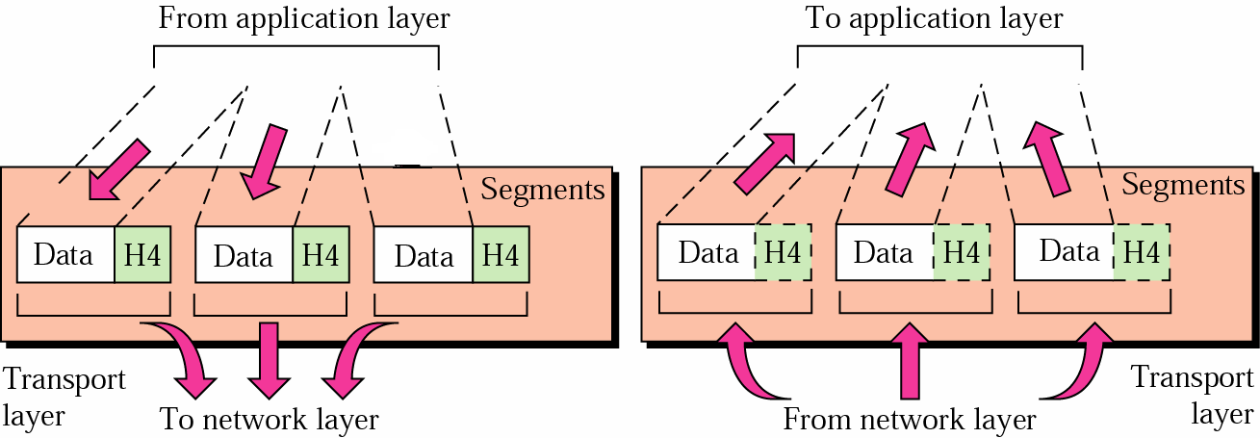
Transport Layer

Slide 30
Session Layer
Main functions of this layer are:
Dialog control – allows two systems to enter into a dialog, keep a track of whose turn it is to transmit
Synchronization – adds check points (synchronization points) into stream of data.
Application
Presentation
Session
Transport
Network
Data Link
Physical

Slide 31
Session Layer
From Presentation Layer
To Presentation Layer
Session Layer
Session Layer
H5
H5
syn
syn
syn
syn
syn
syn
To Transport Layer
From Transport Layer

Slide 32
Presentation Layer
Responsibilities of this layer are:
  Translation
    Different computers use different encoding systems (bit order translation)
    Convert data into a common format before transmitting.
    Syntax represents info such as character codes - how many bits to represent data – 8 or 7 bits
  Compression – reduce number of bits to be transmitted
Application
Presentation
Session
Transport
Network
Data Link
Physical

Slide 33
Presentation Layer
  Encryption – transform data into an unintelligible format at the sending end for data security
  Decryption – at the receiving end
Application
Presentation
Session
Transport
Network
Data Link
Physical

Slide 34
Application Layer
Contains protocols that allow the users to access the network (FTP, HTTP, SMTP, etc)
Does not include application programs such as email, browsers, word processing applications, etc.
Protocols contain utilities and network-based services that support email via SMTP, Internet access via HTTP, file transfer via FTP, etc
Application
Presentation
Session
Transport
Network
Data Link
Physical

Slide 35
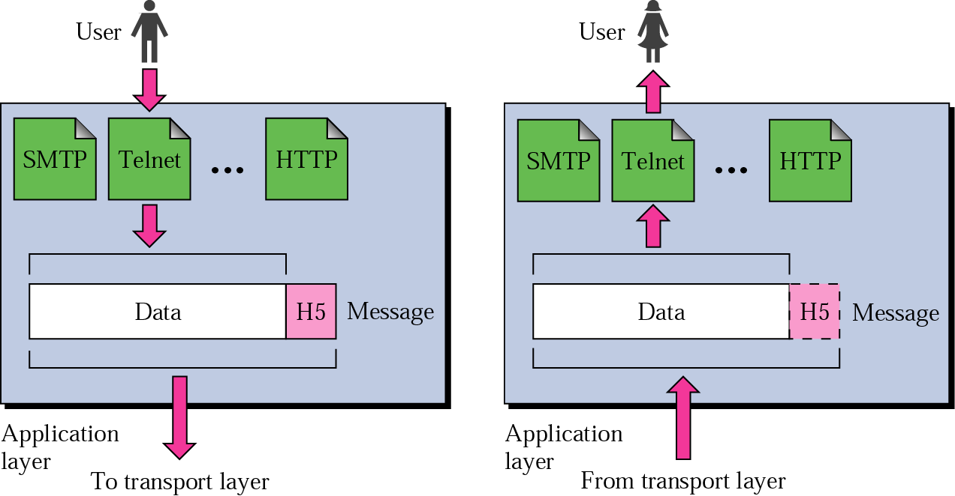
Application Layer
To Presentation Layer
From Presentation Layer

Slide 36
Summary of Functions of Layers
To allow access to network resources
Application
Presentation
Session
Transport
Network
Data Link
Physical
To translate, encrypt and compress data
To establish, manage & terminate sessions
To provide reliable end-to-end message delivery
To move packets from source to destination
To organise bits into frames
To transmit bits over a medium & provide electrical specs.

